Slide 1
Personal Interview
By- Placement Officer PIMR
Sourabh Mehta

Slide 2
Why should we hire you for this position?
Tell me about your achievement ?
What do you look for in a job?
Tell me about your weaknesses ?
Why do you want to join our company?
Tell me about your Carrer Goals?
What are your Strenghts?

Slide 3
1. Why should we hire you for this position?

Slide 4

1. Why should we hire you for this position?
Since this position involves interaction with customers as well as engineering team, my passion for development projects is evident from my choice of engineering as a career. I have also done internship with ABC Software where I learnt about Java and C++. My people skills combined with decision making ability will certainly add value to this position.

Slide 5
2. What are your Strengths?

Slide 6

2. What are your Strengths?
Communication skills is one my strength as I work well with different kind of people and understand different perspective of everyone. Apart from that I am determined, hard worker and active team player
One of my most important strengths include commitment as I always ensure meeting my deadlines and work consistently towards my goals. My other strengths include positive thinking, punctuality and interpersonal skills.

Slide 7
3. Tell me about your weaknesses?

Slide 8
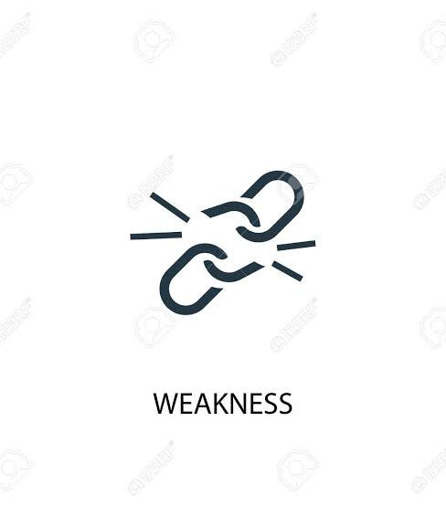
3. Tell me about your weaknesses?
I had a habit of procrastinating, now I am improving and becoming more organized by using to do lists and reminders.

Slide 9
4. Why do you want to join our company?

Slide 10

4. Why do you want to join our company?
I always wanted to work with a company which recognizes talent, as I want to grow and contribute towards the growth of company with my technical and organizational skills. Looking at the growth trend of your company from past 3 years, it will be an honor to work with such an organization.
My Goal is to achieve the highest level of proficiency; I find your company which is India's most admired company, is right place where I can best utilize my education and skills.

Slide 11
5. Tell me about your Achievements?

Slide 12

5. Tell me about your Achievements?
I was chosen as captain of college cricket team and won state level quiz competition.
Because of my leadership skills, I was chosen as captain of college basketball team. And as I am fond of staying updated with current affairs, it made me win state level quiz competition.

Slide 13
6. What do you look for in a job?

Slide 14

6. What do you look for in a job?
I look for opportunities that enable me to grow as professional and help me in serving the organization.
I look for challenges which can bring best out of me and a scope to gain knowledge which enables me to advance in my career path.

Slide 15
7. What are your Career Goals?

Slide 16

7. What are your Career Goals?
My immediate career goals include consistently adding value to myself through learning and upgrading skills. In the long term, I would like to grow as a leader and make myself capable of taking up management positions while contributing significantly to the growth of my organization.

Slide 17
8. Where do you see yourself in 5 years from now?

Slide 18

8. Where do you see yourself in 5 years from now?
My first and foremost aim is to learn new skills and enhance my personality. Five years down that line, I see myself at senior positions while taking more responsibilities and contributing to growth of a reputed organization like yours.

Slide 19
9. What challenges you faced as a student and how you handled them?

Slide 20

9. What challenges you faced as a student and how you handled them?
Since we only grow when we face challenges, so I value each challenge of my life. I always had a problem coping up with subject of Economics. I did not want this to affect my result and career prospects. So I learnt time management to ensure extra time to be spent on same. I went back to basics and sought help from my teachers and friends. And as a result of my determination, I scored 83% in Final Year.
During my third year, I was Captain of College Basketball team. While we were preparing for one of our important match, the team was demotivated and was losing hope as our next match was with a very strong team who had tall players and was winning almost every match. As motivation can do wonders, I took it as a challenge to raise morals and ensure victory of our team despite all the factors against us. I drew a chart to highlight all our strengths, I referred to all our past victories and reasons behind them. I converted entire worry time of team into performance time. As a result, the match went very competitive, we gave our best and won that match.

Slide 21
10. Tell us about your college and why you chose it?

Slide 22

10. Tell us about your college and why you chose it?
While looking for a right college, I got to know that one best thing about this college is that they focus on overall personality development of students. Apart from academics, important stress is laid on participation in events and activities which has helped students like me in developing confidence and team spirit. And in my tenure of three years in this college, the efforts of faculties are evident in the strong foundation which has been laid in each one of us.

Slide 23
11. What type of salary do you expect for this job?

Slide 24

11. What type of salary do you expect for this job?
As a fresher, learning is more important than earning, so my main focus is to gain knowledge. And I do trust that the company pay will be in consistent to market.

Slide 25

SALARY EXPECTATION
1) Research well
2) Calculate
3) Provide Range
4) Question them
I would like to understand more about job position, work profile and career prospects before I quote my salary expectations
What is the standard salary package offered by your organization for this position?

Slide 26
12. Give me an example of your Leadership?

Slide 27

12. Give me an example of your Leadership?
I successfully led the event management team in our college tech fest. I was able to take everyone along while handling challenges and taking collective action. It was a successful event and our team was appreciated by everyone.
As it is said that Knowledge should be shared, not hoarded. I created a WhatsApp group of my classmates to share new words, idioms, phrases etc. Initially, I was the one who used to contribute, gradually many of my classmates have started sharing and as a result we all are getting better daily.

Slide 28
13. Why did you choose career in this field?

Slide 29

13. Why did you choose career in this field?
I was always interested in knowing the other side of any product right from my schooling. And while doing my career research, I explored various career opportunities and discussed with teachers. These influences led me to choose MBA as a course and marketing as my specialization.

Slide 30
14. What if I say that you are rejected?

Slide 31

14. What if I say that you are rejected?
Though I prepared well and performed my level best. But if I am rejected, I will try to see opportunity of learning behind it. I will evaluate and improve myself further to make myself worth for positions like this

Slide 32
15. What if I say that you are rejected?

Slide 33

15. What if I say that you are rejected?
While compiling one of our project report in college, I assumed and misunderstood instructions of my team leader which led to delay in completion. So to avoid any such time and energy waste in future, I took a lesson that instead of assuming, it's always better to ask questions and clarify.

Slide 34
16. Describe ideal working environment for you in an organization?

Slide 35

16. Describe ideal working environment for you in an organization?
Since modern workplace is so dynamic, one should be able to excel in diverse environments. I am more productive in an environment that has good communication and great teamwork, so I believe that will be the ideal working environment for me.
Since modern workplace is so dynamic, one should be able to excel in diverse environments. I am more productive in an environment that has good communication and great teamwork, so I believe that will be the ideal working environment for me.
How do you know that we emphasise on team building?
I went through your company's website and Facebook page while doing the organization research. I noticed lot of team building activities taking place while top management equally involved in them.

Slide 36
17. What kind of people you find difficult to work with?

Slide 37

17. What kind of people you find difficult to work with?
Though I am flexible with all sorts of people as I believe everyone has his or her own way of perceiving things. At times, people who do not stay by their commitments are tough to deal with, but I always try to find ways to ensure that deadlines are met without any personal disagreement.

Slide 38
18. What makes a true manager ?

Slide 39

18. What makes a true manager ?
A true manager is someone who can guide and direct an entire team in a results-oriented business environment. They understand how to motivate, delegate and follow up, to get the job done. They have a clear perception of what it is that they want and how to deliver it to meet and exceed expectations.

Slide 40
19. Have you ever failed in any of your decision? How and why?

Slide 41

19. Have you ever failed in any of your decision? How and why?
As students of journalism, we organized a news reading competition in our college. We managed to get good entries, sponsors, logistics and everything was in place. But on the day of event, audience footfall was 20% of what we expected. We took responsibility of not promoting it well and tried to learn lessons from it. We did not give up and tried again next year, we used active promotion strategies to create interest and increase footfall while making the event successful.

Slide 42
20. What did you learn from your Internship?

Slide 43

20. What did you learn from your Internship?
In my final year, I had an opportunity to work as intern in Oberoi Group into Food and Beverages Department for 2 months. The practical training about customer service and kitchen operations was very helpful for me. I got more insights on ensuring quality standards in the back end while achieving customer satisfaction in front end.

